Slide 1
DIABETES MACHINE LEARNING PREDICTOR
Christin Whitlock
Sumit Malik
Sreedevi Agasthya
Isha Iqbal
Chris Simmons
Jason Cook

Slide 2

Objective
Construct a diabetes prediction app through machine learning algorithms based on diagnostic measurements

Slide 3
Tech Stack
Python
Tableau
Javascript
HTML/CSS
SQL
AWS
Heroku
Scikit Learn
Scikit-Plot
Pickle
Pandas
SQLAlchemy
Seaborn
Matplotlib
Flask
JQuery
Plotly
D3
Bootstrap
S3
Postgres
Notes:
Heroku and aws

Slide 4
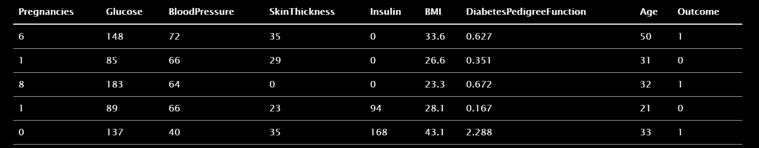
Dataset
Source
National Institute of Diabetes and Digestive and Kidney Diseases
Demographic
Females
Ages 21+
Pima Indian Heritage
Data Cleanup
Remove zero/null values
768 Rows to 724 Rows

Slide 5
Features
Glucose
Pregnancies
Blood Pressure
Skin Thickness
Insulin
Body mass index
Diabetes Pedigree Function
Age
Notes:
correlation matrix on right side (features)

Slide 6
Feature Ranges
Plasma Glucose Test (mg/dL) | Normal | Pre-Diabetes | Diabetes
 | Below 140 | 140 to 199 | Above 200
BMI (kg/m²) | Underweight | Normal | Overweight | Obese
 | Below 18.5 | 18.5-25 | 25-30 | Above 30
Blood Pressure (mm Hg) | Normal | Pre-Hypertension | Hypertension
 | Below 80 | 80-89 | Above 90
Insulin (mu U/ml) | Normal
 | 16-166
Skin Thickness (mm) | Normal
 | ~23

Slide 7
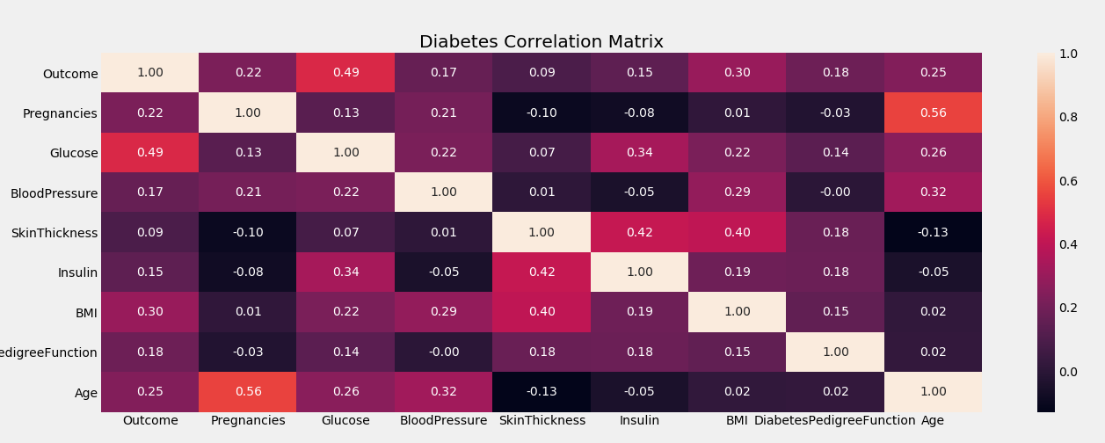
Correlation Heat Map
Correlation to Outcome
Glucose – 49%
BMI – 30%
Age – 25%
Pregnancies – 22%
Blood Pressure – 17%
Insulin – 15%
Skin Thickness – 9%

Slide 8
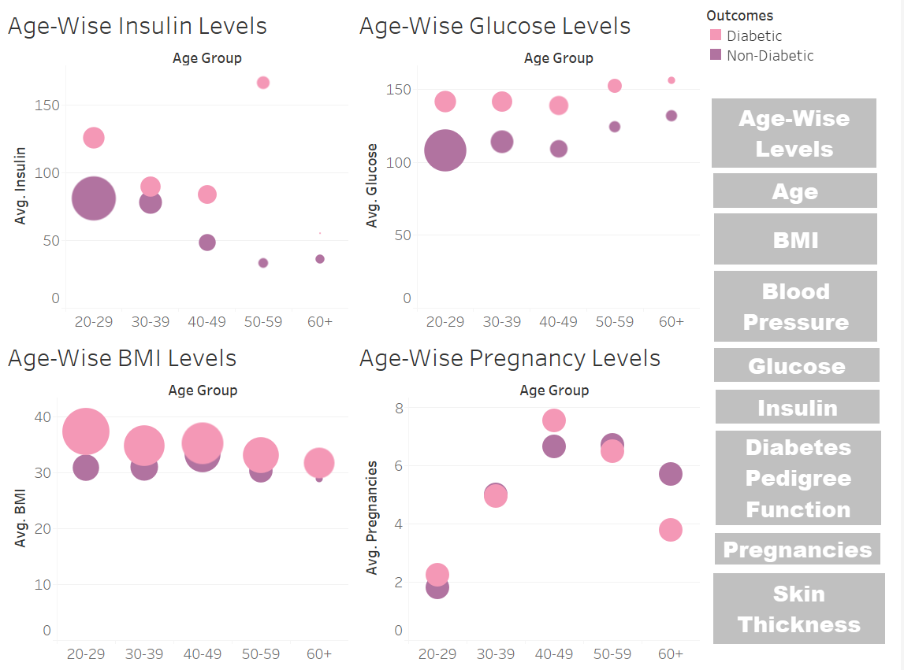
Normalized Variable Levels
Notes:
Create hyperlink to tableau page

Slide 9
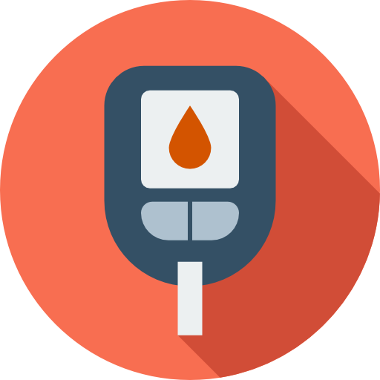
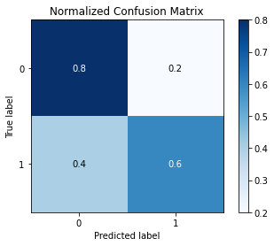
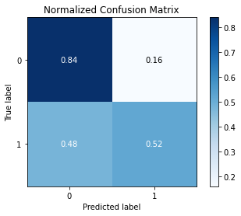

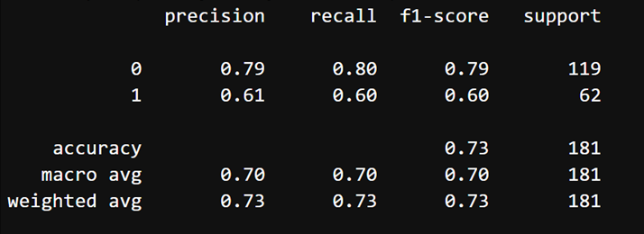
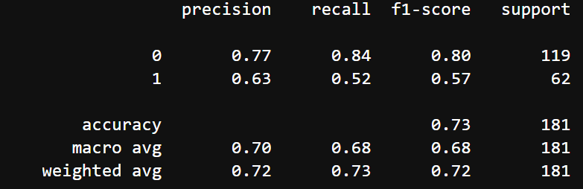
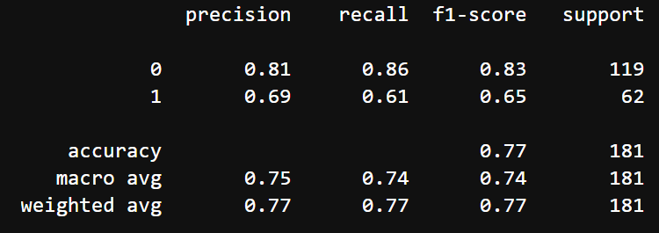
Classification Models
Decision Tree
KNN
Gradient Boosting

Slide 10
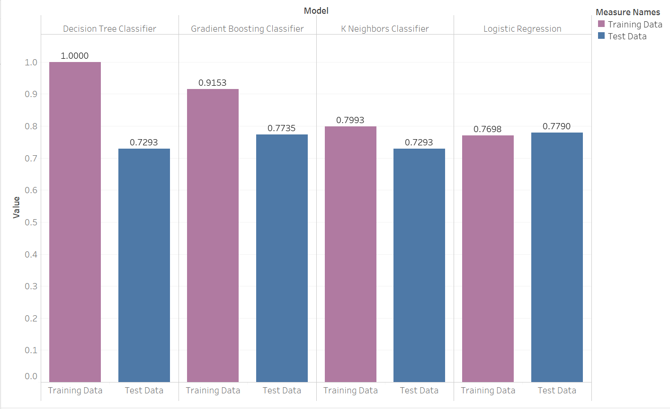
Classification Models Comparison
Notes:
File size

Slide 11

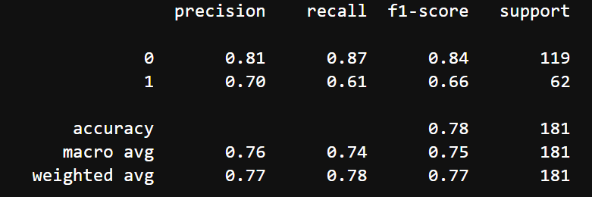
Our Model Logistic Regression Classification Model
Notes:
all models on one page and box over LR

Slide 12
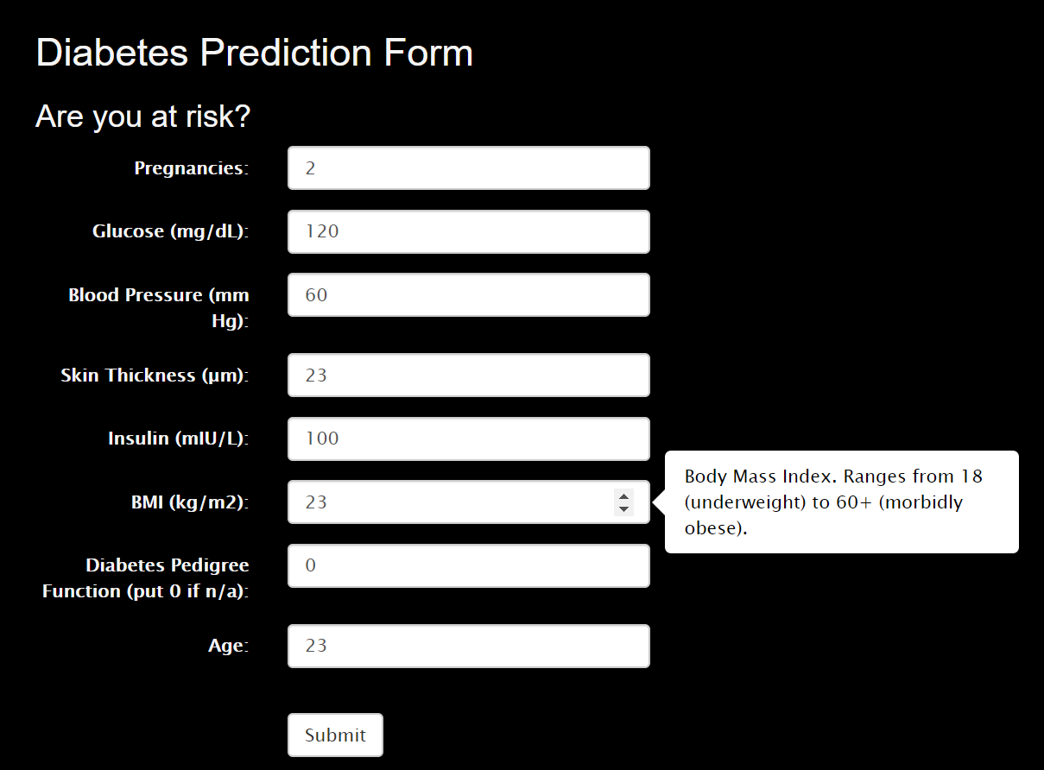
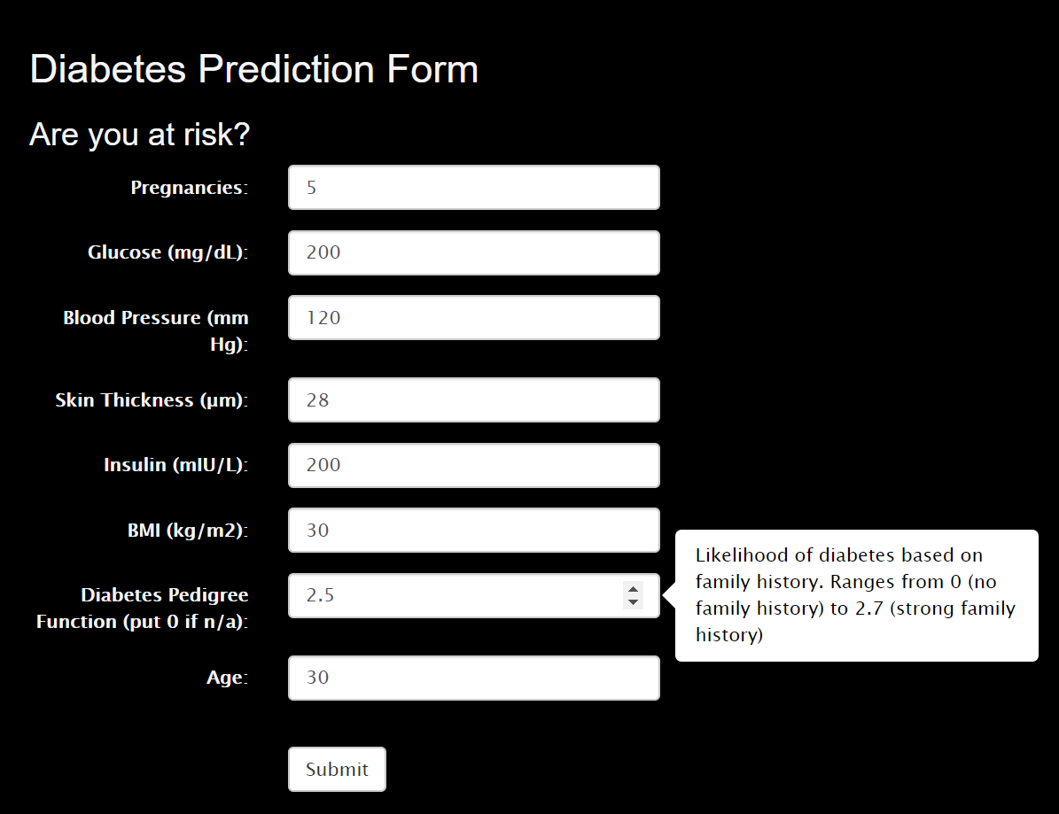
Prediction Form
Non-Diabetic
Diabetic

Slide 13
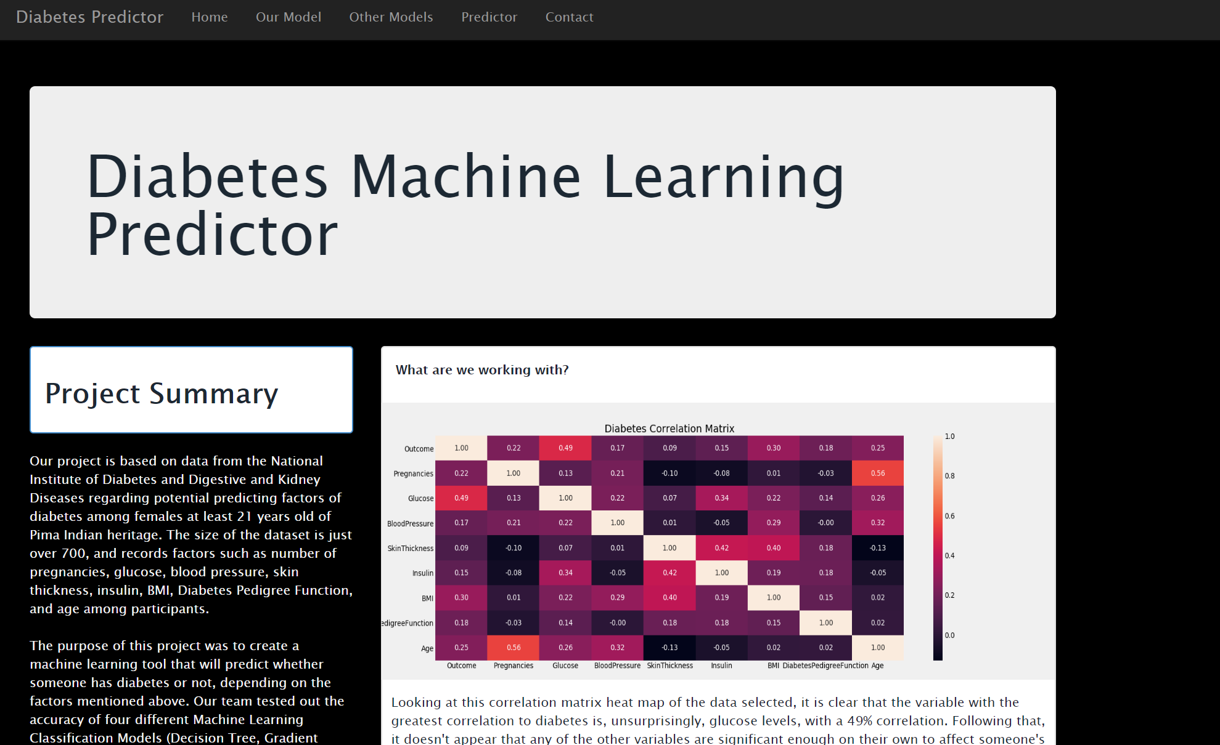
Our App

Slide 14
Next Steps
Usage statistics
Utilize form input data to build a more accurate model
Notes:
footer add bar final project dark shade

